Slide 1

BEGINNING OF TUTORIAL
F
RAMES
tutorial
Click to begin

Slide 2
TABLE OF CONTENTS
Tutorial overview – FAMILIARIZES USERS WITH TUTORIAL FEATURES
Tutorial introduction – INTRODUCES THE STORY IN WHICH THE TUTORIAL IS BASED ON
Creating a new scenario – GETTING STARTED BY CREATING A NEW GID FILE
Dragging and dropping icons – PLACING MODULE ICONS ONTO THE CSM
Connecting icons – SIMULATES THE CONTAMINANT FLOW THROUGH THE MODULES
Setting up the Contaminant module – STEP BY STEP INSTRUCTIONS AND ANIMATIONS
Setting up the Source Term module – STEP BY STEP INSTRUCTIONS AND ANIMATIONS
Setting up remaining modules – PROVIDES DATA FOR USERS TO INPUT
Selecting a viewer – EXPLAINS OPTIONS FOR VIEWING RESULTS
Table of Contents

Slide 3
OVERVIEW
What is the purpose of the FRAMES 1.3 Tutorial?
This tutorial describes how to start using the FRAMES software. The user will gain a more complete understanding of how to use FRAMES by building an example case. Step-by-step instructions to build a case are given starting with a case scenario and ending with viewing results.
FRAMES 1.3 Tutorial Features
To view the previous page, click on the ( ) button.
To view the next page, click on the ( ) button.
To end the tutorial and return to the main FRAMES page, click on the ( ) button
To return to the Tutorial Table of Contents, click on the ( ) button.
Underlined words throughout the tutorial will take you to the reference section. To return to the tutorial after browsing through the reference section, simply hit the ESC button on your keyboard.
If the navigation buttons below are grayed out ( ), it means that it has been disabled.
The navigational bar at the bottom of the page indicates the progress of the user through a specific section.
Overview

Slide 4
INTRODUCTION
Tutorial Introduction
Every contaminated site has a story behind the scenes, containing explanations and descriptions of the location and exposure pathways. This is the story for the scenario used in the FRAMES 1.3 Tutorial. The data used to fill in this example scenario is consistent with the story told below. After completing this test scenario, you should be able to start with your own site and run a scenario. Step by step instructions are included throughout Getting Started. Read the following scenario and follow the instructions to create your own scenario.
The “story” behind the scenario
Beginning in November of 1995, a manufacturing company deposited its radioactive and nonradioactive by-products onto the ground in a 10’ x 10’ area. The deposit is not covered. The waste represents the only waste unit at the facility. The site is near the Green Stone River. The Site was ordered closed by the U.S. Environmental Protection Agency. Constituents of concern include antimony, strontium 90, and trichloroethylene.
While the site was still active, mechanical traffic and poor management practices resulted in a considerable amount of wind-blown particulate matter to be transported from the site. Over the years, the residential soil of the nearby town of Fieldview became contaminated. Residential soil samples have been taken.
Samples have also been taken of the site sediments. The river is used for drinking water, irrigation and stock/feed water for livestock. Also, fishing and swimming occur on this stretch of the river. The local population consumes aquatic life from the river, and locally grown crops and livestock.
Introduction

Slide 5
INTRODUCTION
. . . the “story” continued
There is an intake structure downstream where the contaminants enter the river; this structure is used to supply feed/stock water and irrigation water to two nearby agricultural farms: one in Bend County and one in Blue County. Inorganics were not sampled for in the river, but organics were sampled for. Measured concentrations of carbon tetrachloride have been detected five miles downstream from the facility.
Contaminants have been measured in the local groundwater in the local groundwater system. Several private and municipal wells use the groundwater from the same aquifer; however, most of the wells are located significantly up gradient from the landfill, are uncontaminated, and do not change the groundwater flow system when pumping. One pumping well though is located down gradient of the waste site, and is contaminated with low levels of constituents. This well is currently being used as a municipal drinking water well for the town of Fieldview. Besides contaminating the pumping well, the contaminated groundwater also recharges to the Green Stone River.
On hot days, local residents have complained of pungent odors, suggesting volatilization of chemicals; three of the chemicals of concern can volatilize. The area is heavily agricultural and dry deposition of contaminants on plants and consumption by humans is possible. It is also possible for plants to uptake residual chemicals from the soil. All records and information pertaining to the site, including maps, photographs, and sampling result summaries are stored at the County Health Department in Fieldview.
The following tutorial will demonstrate how to use this documented information to conduct an analysis in FRAMES 1.3.
Introduction

Slide 6
CREATING A NEW SCENARIO
Creating a new *.gid file
The following steps used for this tutorial will be the similar to every case, but the icons and data used will vary from case to case.
After opening FRAMES, the Main Screen will appear, characterized by a gray background. To begin a new FRAMES case, a GID file must be opened. A GID (Global Input Data) file is simply the file extension used for the user input file in FRAMES. This can be an already existing file or a new file. In this scenario, we will create a new file.
Click on the File menu at the top left hand corner of the screen, and choose ‘New.’
A window will appear, prompting you to save this new file under a specific folder and file name.
For this scenario, select an appropriate folder, and type in “Case01” as the file name. The file name should be no longer than 8 characters with no spaces or special characters. The extension, GID, stands for Global Input Data file.
If you choose to cancel the screen without saivng, you will be unable to continue with the case. Click on the ‘Save’ button to continue.
A new FRAMES interface will appear, allowing you to begin a new case.
For more details on the opening an existing file, refer to the reference section.
CLICK TO VIEW ANIMATION
New Scenario

Slide 7
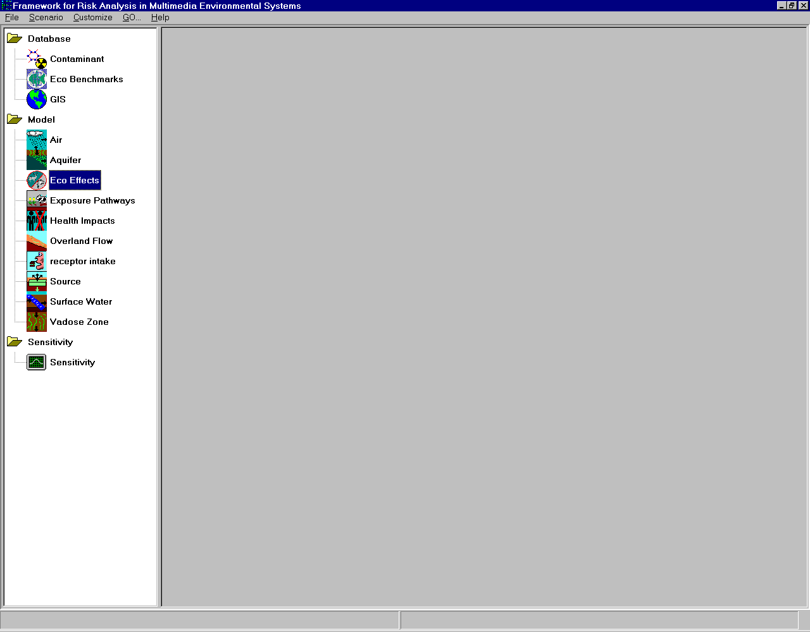
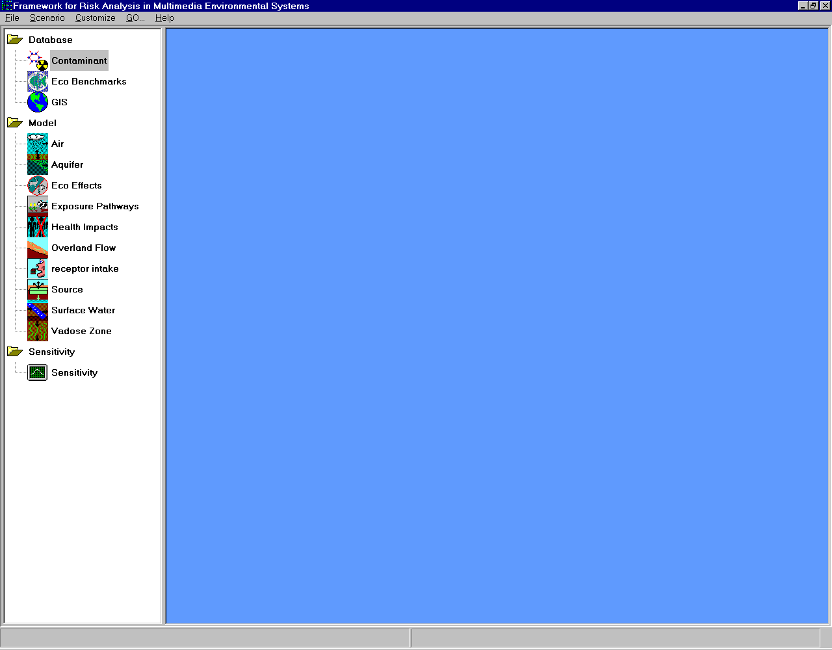
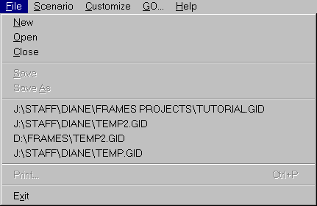
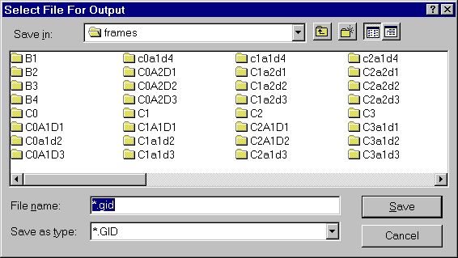
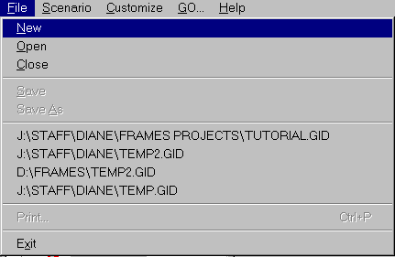
(AM)
Case01
RETURN TO:
“Creating a new *.gid file.”

Slide 8









DRAGGING AND DROPPING ICONS
Inserting icons into the CSM
The following icons used are for the sample case only. To view a comprehensive list of icon information, refer to the reference section.
Double click on the contaminant icon ( ) The icon should appear on the right side of the screen, within the main user interface. Do this for each of the following icons:
Insert the Source Term icon ( )
Insert the Vadose Zone icon ( )
Insert another Vadoze Zone icon. Each icon represents one layer of soil.
Insert the Aquifer Module ( )
Insert the Surface Water Module icon ( )
Insert the Air icon ( )
Insert the Exposure Pathways Module icon ( )
Insert the Receptor Intake Module icon ( )
Insert the Health Impacts Module icon ( )
CLICK TO VIEW ANIMATION
Icons

Slide 9



















(AM)
RETURN TO:
“Inserting icons into the CSM”

Slide 10
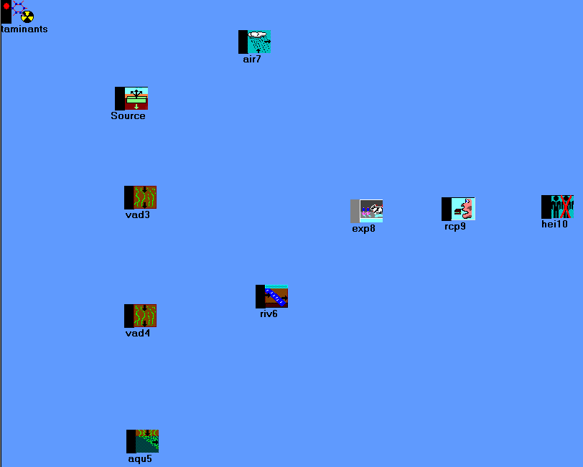
DRAGGING AND DROPPING ICONS
Arranging icons within the CSM
It is a good idea to arrange the icons in a more logical way so that it accurately simulates the flow of contamination.
Click on the contaminant database module icon, and (using your mouse) drag it to the desired location (without releasing the mouse). Once the icon is in the desired position, the mouse can be released. This process is called “dragging and dropping” an icon.
Drag and drop the different icons until the following layout is achieved:
CLICK TO VIEW ANIMATION
Icons

Slide 11









(AM)
RETURN TO:
“Arranging icons within the CSM”

Slide 12
CONNECTING ICONS
Connecting Icons
It is essential to link icons in the order of the flow of contamination. To link two icons together, hold down the shift key while left clicking on the initial icon and dragging the mouse to the next icon. Make the following connections between:
  The con1 icon and each of the other icons on the main screen.
  Src2 icon and vad3 icon
  Src2 icon and air7 icon
  Air7 icon and exp8 icon
  Vad3 icon and vad4 icon
  Vad4 icon and aqu5 icon
  Aqu5 icon and riv6 icon
  Aqu5 icon and exp8 icon
  Riv6 icon and exp8 icon
  exp8 icon and rcp9 icon
  Rcp9 icon and hei10 icon
Any number and direction of connections is permitted between icons. However, certain modules may limit the connections. Different colored lines and arrows are used to distinguish between database, sensitivity, and module links.
For more details on adding, removing, or deleting a linkage, refer to the reference section.
CLICK TO VIEW ANIMATION
Icons

Slide 13
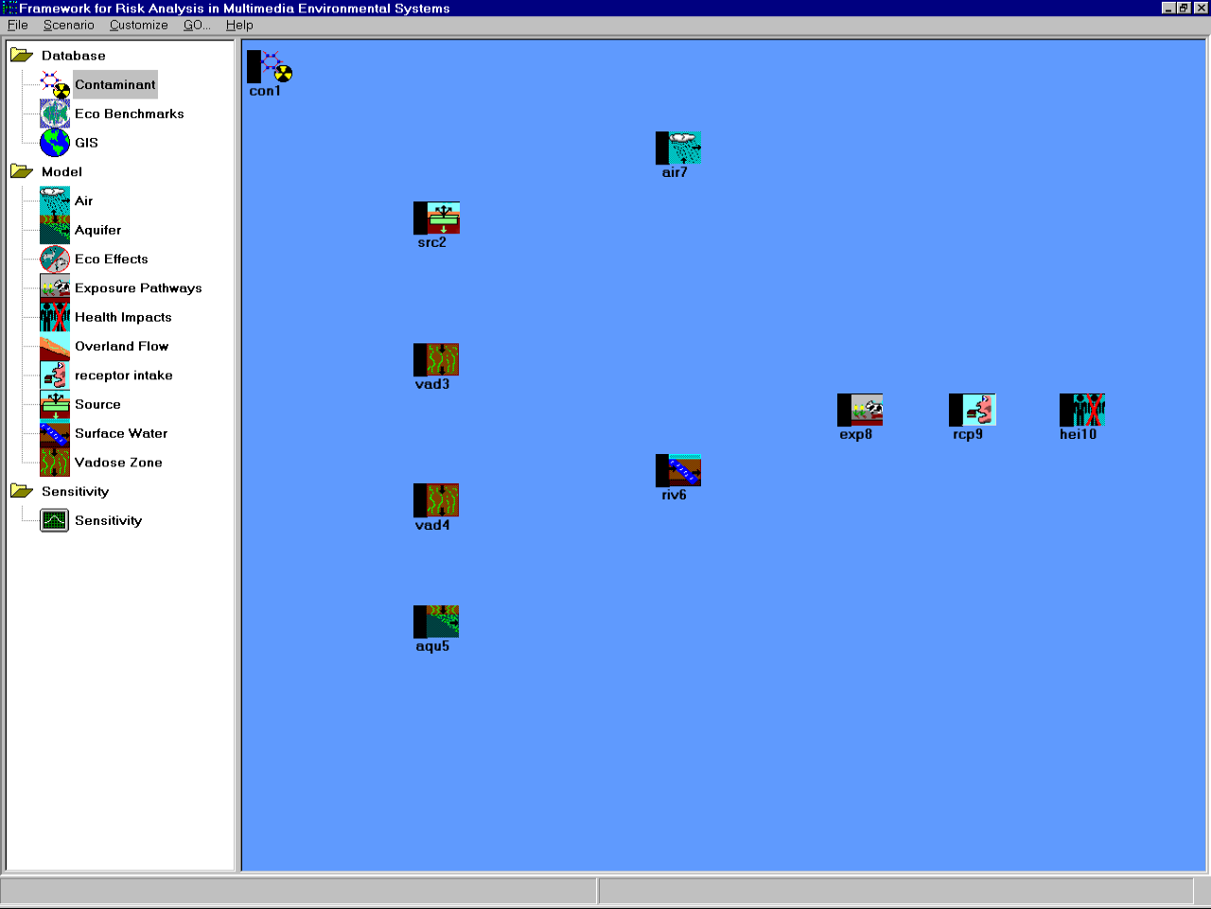



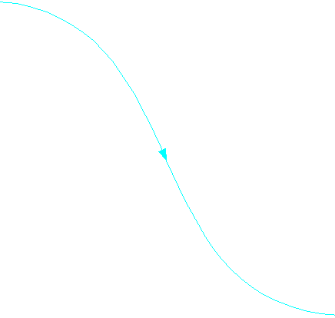

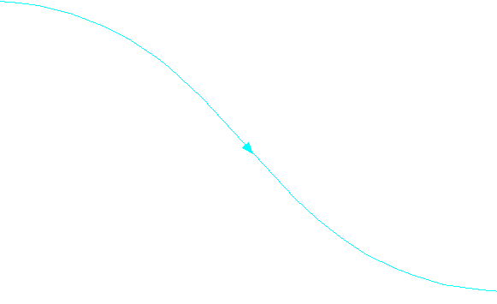
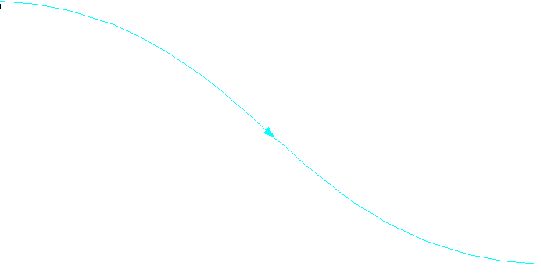



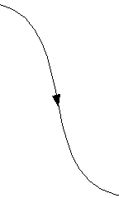
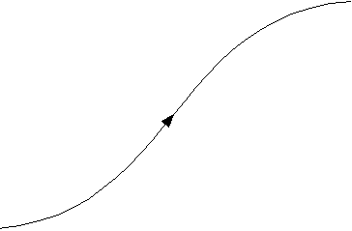

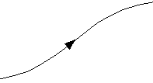
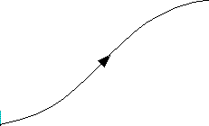
(AM)
RETURN TO:
“Arranging icons within the CSM”

Slide 14
THE CONTAMINANT DATABASE MODULE
Selecting a Module
Right click on the Contaminant Database icon
Select “General Info” from the pop-up menu
The Object General Information screen will open.
A user-defined label can be entered to replace the default. In this scenario, enter Contaminants in the label section
Many modules have multiple applicable and non-applicable models. However, there is only one Applicable Model and no Non-applicable models for the Contaminant Database. Select the FRAMES Default Chemical Database Selection, and the Model Description should appear on the right side of the screen.
Click “Ok.” The screen will close and the main FRAMES user interface will reappear
CLICK TO VIEW ANIMATION
Modules

Slide 15
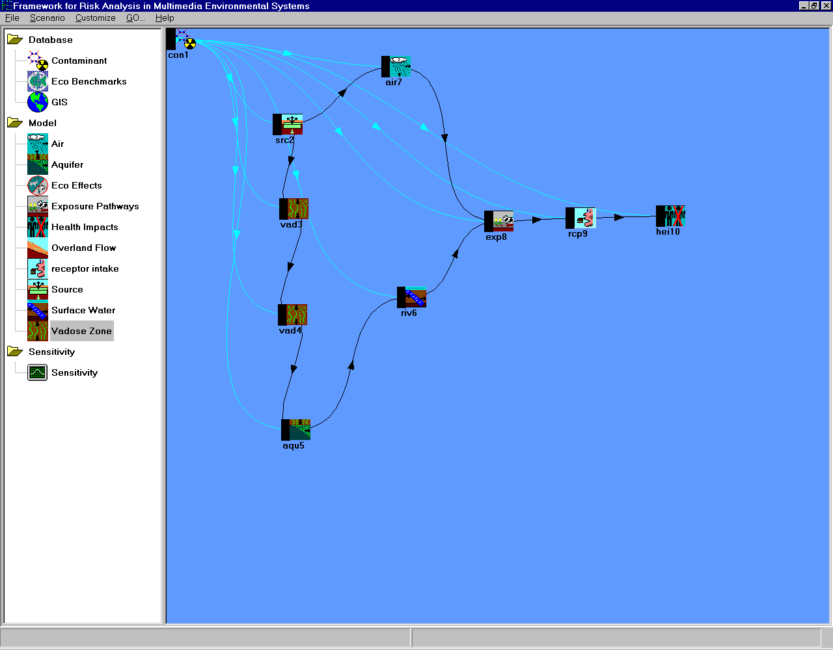

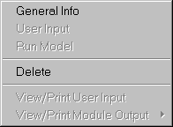
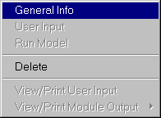
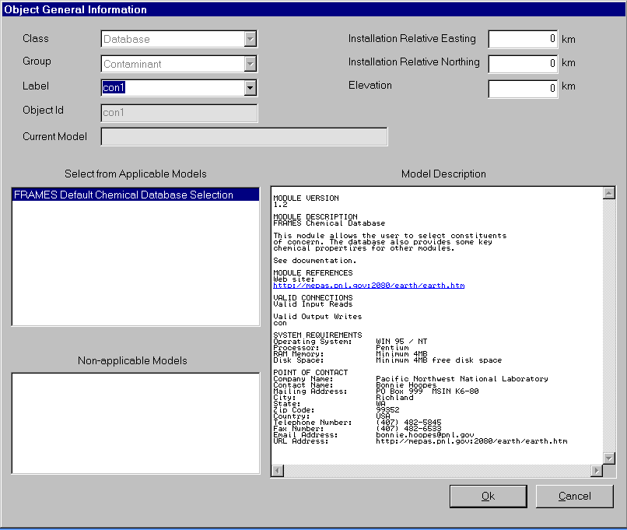
(AM)
Contaminants
RETURN TO:
“Selecting a module”

Slide 16
THE CONTAMINANT DATABASE MODULE
Choosing Contaminants
Notice the black side bar of the Contaminant Database Icon. This color will change every time a step is completed. At this point, the light should be red. For more details on the lighting system, refer to the reference section.
Right click the Contaminant icon and choose “User Input” from the menu.
The FRAMES Constituent Database Editor screen will open.
Several tabs span across the window. For this (and most) scenario, use the defaults provided in the Constituent Identification and Constituent Properties. The main concern is the “Constituent of Interest” tab which allows the user to enter the scenario-specific contaminants
There are several different ways to group contaminants to narrow the selection and assist in finding the desired contaminant. For this example case, use the default selections in the Constituent View Options area.
Type “Antimony” in the ‘Search for:’ box below. The search will automatically find the first listing of the contaminant.
Click Find Next until the specific contaminant is found. Once the desired contaminant is highlighted, click ‘Add,’ and the contaminant will appear on the right.
Repeat these steps to add Strontium-90 and Trichloroethylene to the list.
An unlimited number of contaminants can be added to the scenario in any order. They will appear alphabetized on the right side of the screen.To remove a contaminant from the scenario, highlight the contaminant on the right side of the screen and click ‘Remove.’
4) Click on the ‘File menu’ and choose ‘Exit and Save Changes.’ This will bring you back to the main user interface screen, and concludes the Contaminant Database Icon setup. Unlike other modules, the Contaminant Database module does not need to be run. Also notice that a green light will appear on the side of the icon.
CLICK TO VIEW ANIMATION
Modules

Slide 17
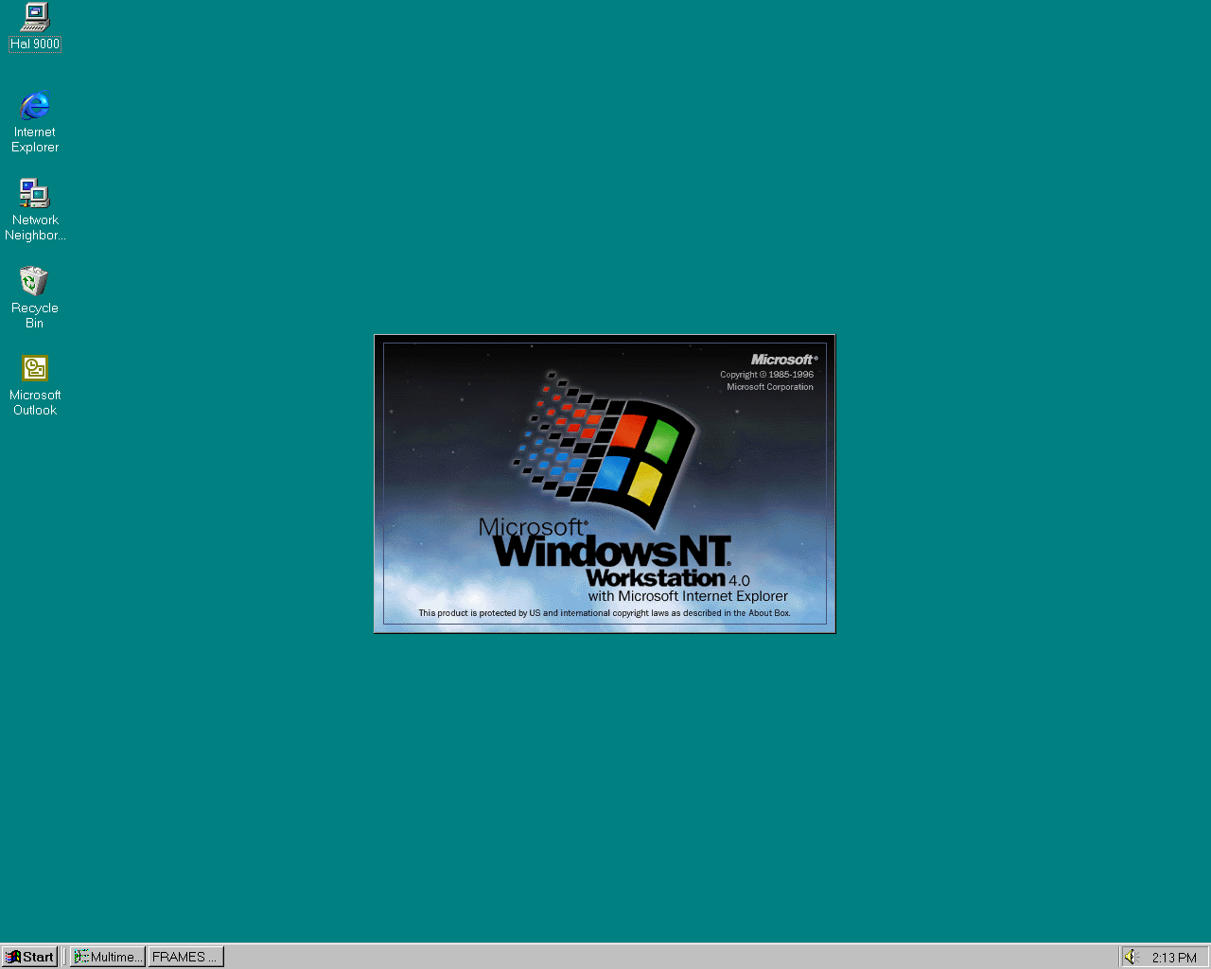
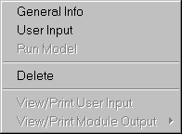
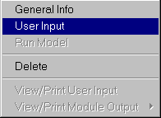
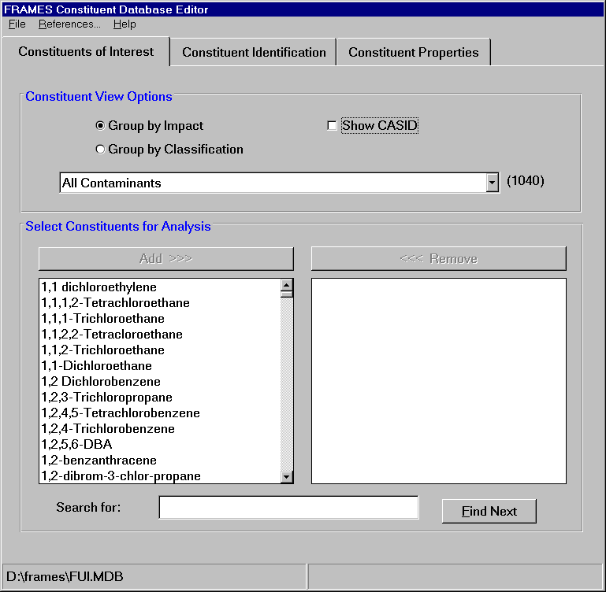
(AM)
Click to continue…

Slide 18
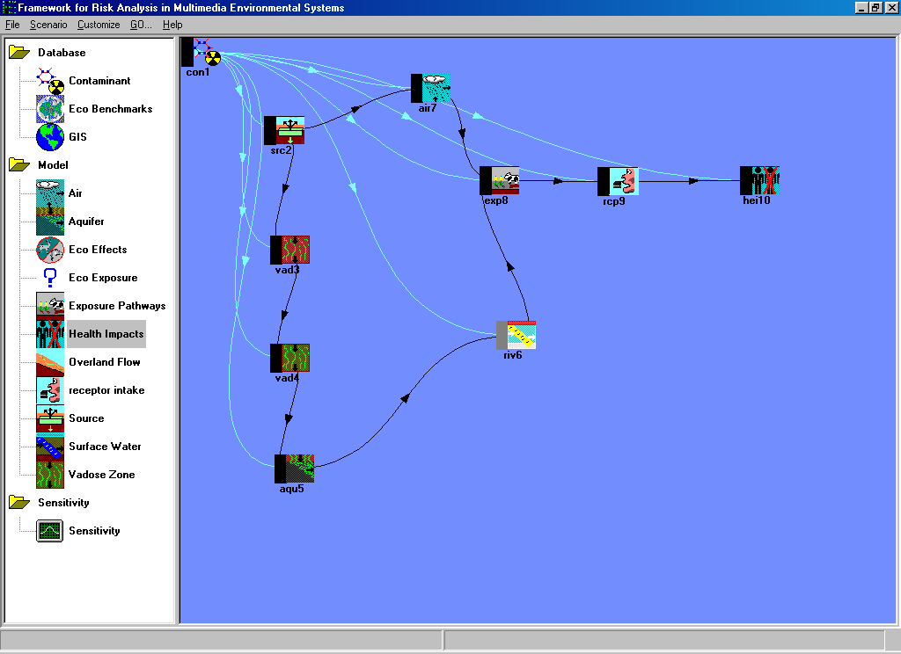


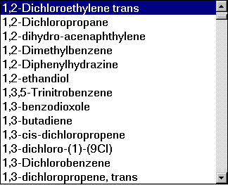
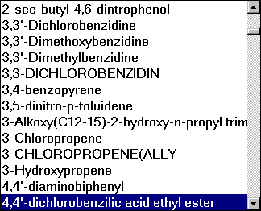
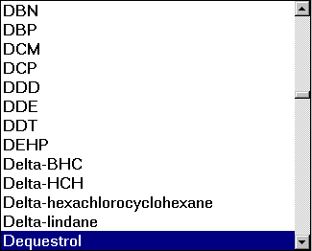
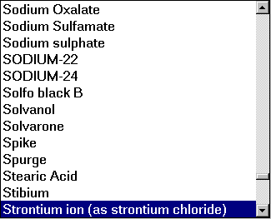
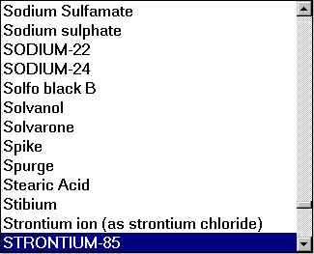
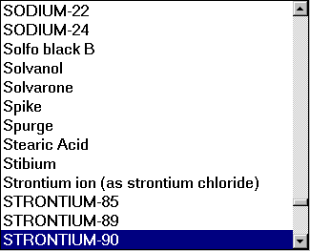
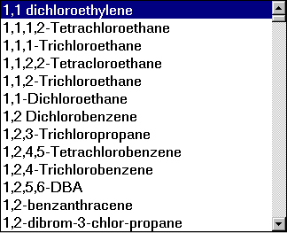
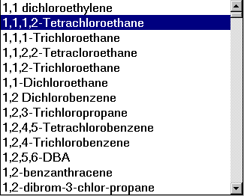
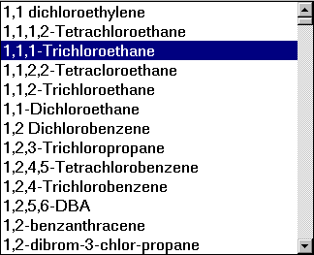
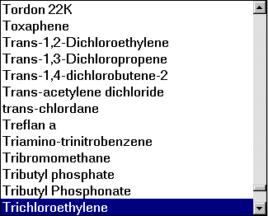
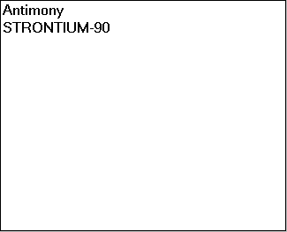
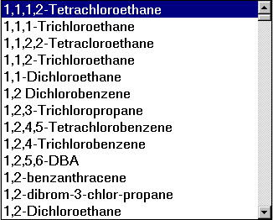
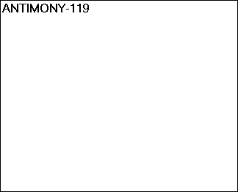
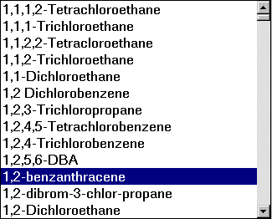
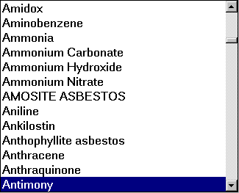
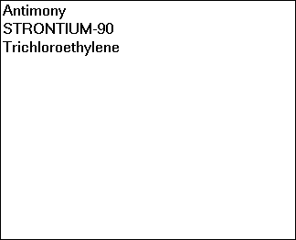
(AM)
RETURN TO:
“Choosing Contaminants”
Antimony
trichloroethylene
Strontium-90

Slide 19
THE SOURCE TERM MODULE
Selecting a Module
Right click on the Source Term module icon
Select “General Info” from the pop-up menu
The Object General Information screen will open.
Enter “Source” as the label in the label section
In the ‘Select from Applicable Models’ list, choose the “MEPAS 4.1 Computed Source Term Release Module.” The model description will appear at the right of the screen.
Click “Ok.” The screen will close and the main FRAMES user interface will reappear
CLICK TO VIEW ANIMATION
Modules

Slide 20
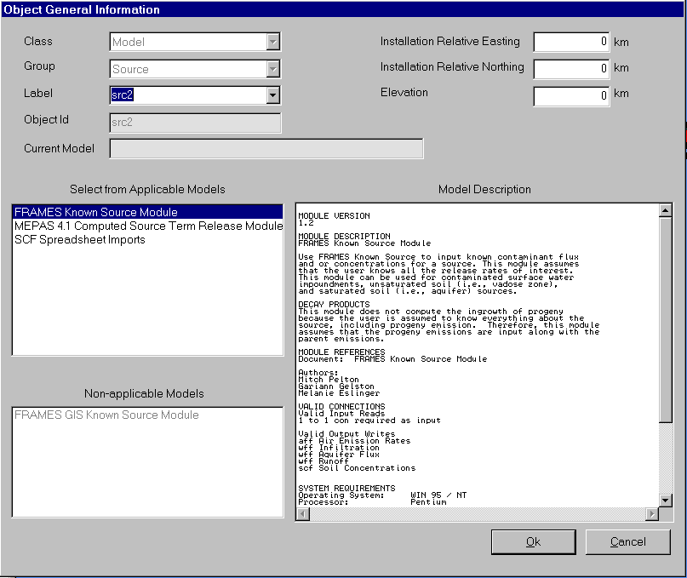

(AM)
Click to continue…

Slide 21
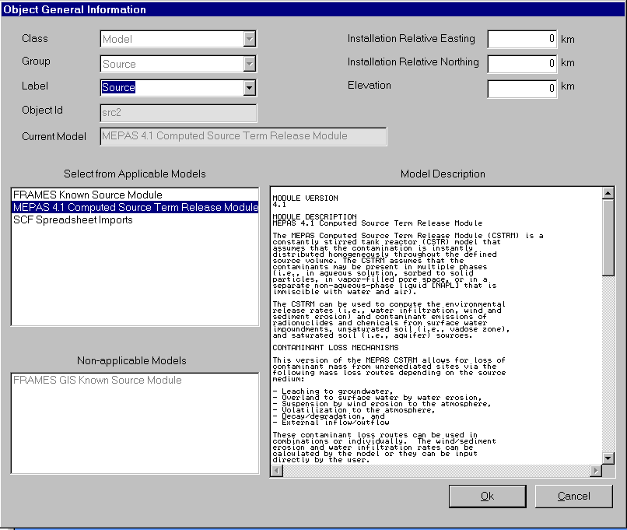
(AM)
Source
RETURN TO:
“Selecting a module”

Slide 22
THE SOURCE TERM MODULE
Inputting Data
Notice the black side bar of the Contaminant Database Icon. This color will change every time a step is completed. At this point, the light should be red. For more details on the lighting system, click here.
Right click the Source Icon
Choose “User Input” from the menu.
The Source Term Module Input screen will open.
Once the User Input screen has opened, click ‘OK’ to dismiss the “About MEPAS CSTRM” window.
Input the scenario specific data as indicated by the tables provided in the following slides.
Boxes will be shaded either red or green. A red box signifies missing information that needs to be filled in. The user will be unable to continue if red boxes are not filled in. A green box signifies that the data is acceptable.
The user must also make sure that the inputted values are within its numeric value range. This can be found at the bottom of the screen, once the cursor is placed inside of the box.
The bold headings at the top of the table indicates the section as specified by the tabs across the top of the window. Enter the data under the appropriate tab. An empty parameter entry shown by a red box can cause an error message after you click ‘Exit and Save.’ The error message will appear and should tell you which parameter is incorrect/empty. The data must be entered before the scenario can proceed.
To view tables, proceed onto the next page. In this tutorial, an animation will be provided as a guide to filling out the “Options” tab. The rest of the tabs will be shown through screen captures.
CLICK TO VIEW TABLES
Modules

Slide 23
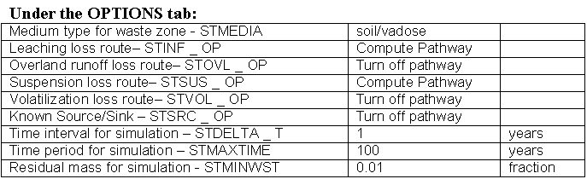
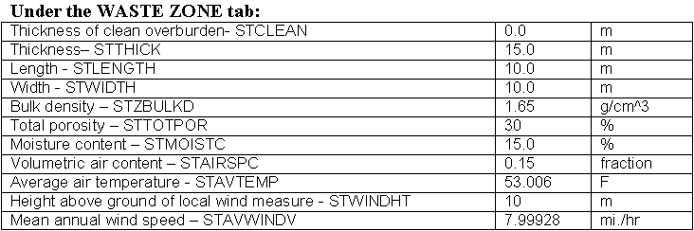
THE SOURCE TERM MODULE
CLICK TO VIEW ANIMATION
CLICK TO VIEW SCREEN CAPTURES
Data Tables

Slide 24
(AM)
Click to continue…
THE CONTAMINANT DATABASE ICON
Inputting Data (1 of 2)
Notice the black side bar of the Contaminant Database Icon. This color will change every time a step is completed. At this point, the light should be red. For more details on the lighting system, click here.
Right click the Source Icon
Choose “User Input” from the menu.
The Source Term Module Input screen will open.
Click to view animation

Slide 25
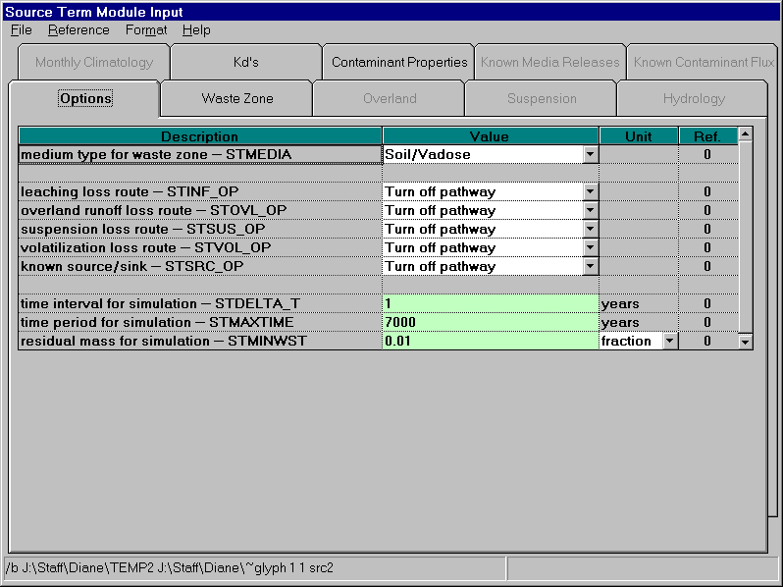
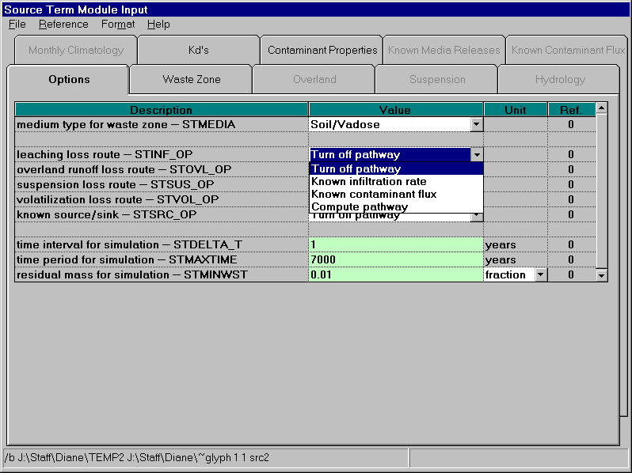
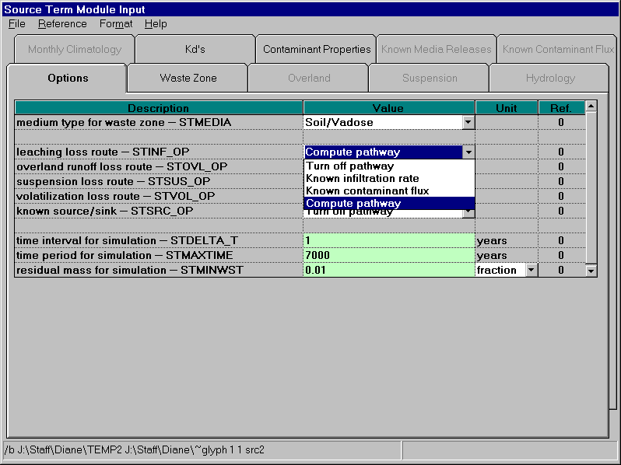
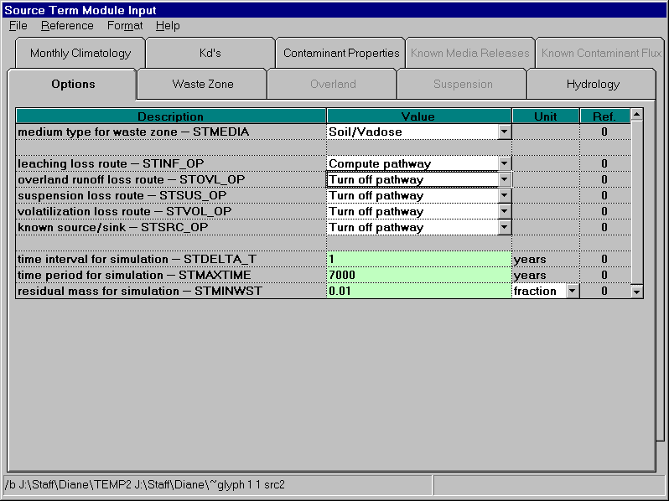
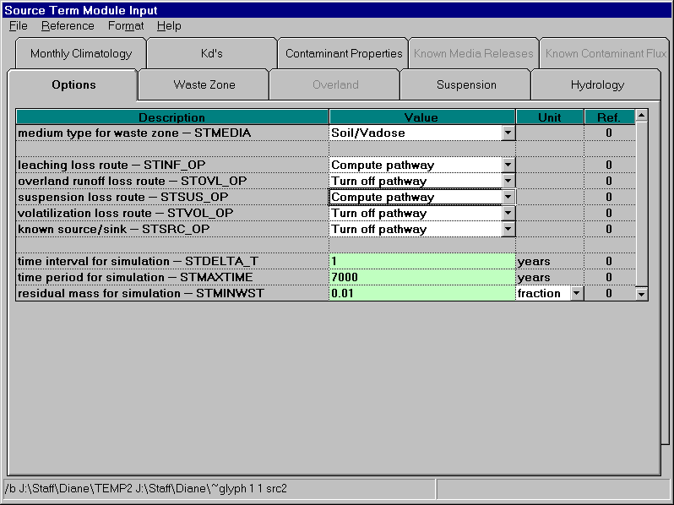

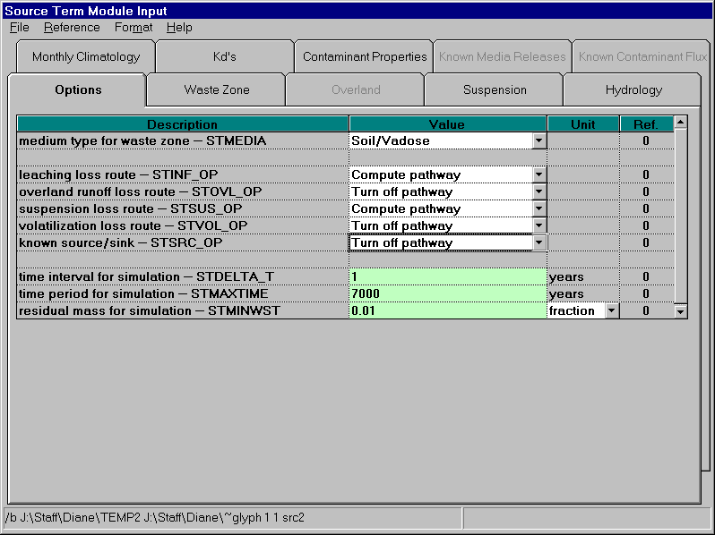
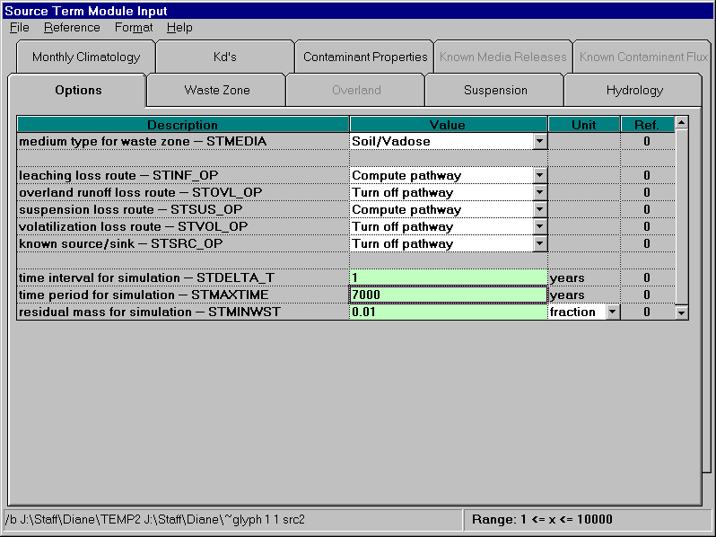



(AM)
100
RETURN TO:
“Tables”

Slide 26

(a)_ Waste Zone
THE SOURCE TERM MODULE
Inputting Data (3 of 8)
Waste Zone
Back to tables

Slide 27


THE SOURCE TERM MODULE
CLICK TO VIEW SCREEN CAPTURES
CLICK TO VIEW SCREEN CAPTURES
Data Tables

Slide 28

(a)_ Suspension
Back to tables

Slide 29

(a)_ Hydrology
THE SOURCE TERM MODULE
Inputting Data (5 of 8)
Hydrology
Back to tables

Slide 30


THE SOURCE TERM MODULE
CLICK TO VIEW SCREEN CAPTURES
CLICK TO VIEW SCREEN CAPTURES
Data Tables

Slide 31

(a)_ Monthly Climatology
THE SOURCE TERM MODULE
Inputting Data (6 of 8)
Monthly Climatology
Back to tables

Slide 32

(a)_Kd’s
THE SOURCE TERM MODULE
Inputting Data (7 of 8)
K_{d}’s
Back to tables

Slide 33

THE SOURCE TERM MODULE
CLICK TO VIEW SCREEN CAPTURES
Data Tables

Slide 34

(a)_Contaminant Properties
THE SOURCE TERM MODULE
Inputting Data (7 of 8)
Contaminant Properties
Back to tables

Slide 35
THE SOURCE TERM MODULE
Running the Model
After all necessary data has been inputted, the light on the side bar of the source term module icon will turn yellow. This indicates that the model is ready to be run.
To run the model, right-click on the source term module icon and choose “Run Model.” The FRAMES user interface will close and the model will run in a MS-DOS screen before returning to the main FRAMES window.
Models can be run at any time during the scenario, as long as all data has been inputted, and the light has turned yellow.
To run all models at one time, use the “GO” button. Refer to the reference section for more details.
CLICK TO VIEW ANIMATION
Modules

Slide 36




RETURN TO:
“Running Models”

Slide 37
THE SOURCE TERM MODULE
Selecting a Viewer
The FRAMES user interface provides viewers that allow users to view text and graphical information produced by modules that meet the FRAMES data file specifications. Viewers and chart viewers are available to view .WFF, .WCF, .SCF, .EPF, .RIF, and .HIF files.
To view results, the signal light on the module must be green, signaling the run has been completed. Once it is green, the results can be viewed anytime.
Right-click on the module icon and select “View/Print Module Output” from the popup menu.
Select the desired viewer from the View/Print Module Output list. There are at least two choices for each viewer attached to a module: a graphical and text viewer.The graphical option is usually the most effective way to view data. To see the results in the various viewers, reselect a different viewer.
The remaining modules to be set up for this example case scenario are described in the following slides, in much less detail, but in similar fashion to the source term module and the contaminant database module. The tutorial will lead the user through each remaining module and provide the data needed for the user input.
Consequent screen captures of (1) the module’s Object General Inforamation screen, and (2), the first tab of the module’s “User Input” screen, will be shown at the bottom of the page, for each module. Upon exiting each of these screens, be sure to go to the file menu and choose “Exit – Save Changes.”
CLICK TO VIEW ANIMATION
Modules

Slide 38





RETURN TO:
“Selecting a Viewer”

Slide 39


VADOSE ZONE
Vadose Zone Module (1)
After the Source Term module, the next module is the Vadose Zone Module, which simulates the movement of solutes through partially saturated porous media. Multiple Vadose Zone icons can be attached to the Source Term depicting the different medium layers (i.e., soil, clay, etc). For more details on this module, click here.
Right click on the vadose zone icon and choose ‘General Info’ from the menu. The Object General Information screen will appear. Type in “Vadose_1” for the label.
Highlight the MEPAS 4.1 Vadose Zone Module on the list of Applicable Models on the left side of the screen, and click ‘OK.’ The signal light on the main screen should turn red, signaling the step was successfully completed.
Right click on the icon again, and choose ‘User Input.’ Another screen will open and you can begin inputting data. For the data input information for this module, click here.
Modules

Slide 40
VADOZE ZONE (2)
Vadose Zone Module (2)
A second vadoze zone icon is needed to simulate the two layers of soil which is crucial to the scenario simulation.
Right click on the vadose zone icon again and choose ‘General Info’ from the menu. The Object General Information screen will appear. Type in “Vadose_2” for the label. Highlight the MEPAS 4.1 Vadose Zone Module on the list of Applicable Models on the left side of the screen, and click ‘OK.’ The signal light on the main screen should turn red, signaling the step was successfully completed.
Right click on the icon again, and choose ‘User Input.’ Another screen will open and you can begin inputting data. For the data input information for this module, click here.
Modules

Slide 41


AQUIFER MODULE
Aquifer Module
The Aquifer Module also known as the Saturated Zone Module simulates the movement of solutes through saturated porous media. For more details on this module, click here.
Right click on the aquifer icon and choose ‘General Info’ from the menu. The Object General Information screen will appear. Type in “Aquifer” for the label. Highlight the MEPAS 4.1 Saturated Zone Module on the list of Applicable Models on the left side of the screen, and click ‘OK.’ The signal light on the main screen should turn red, signaling the step was successfully completed.
Right click on the aquifer icon again, and choose ‘User Input.’ Another screen will open and you can begin inputting data. For the data input information on this module, click here.
Modules

Slide 42


SURFACE WATER
Surface Water Module
The Surface Water Module is also known as the River Module and simulates the movement of solutes through non-tidal rivers. For more details on this module, click here.
Right click on the icon and choose ‘General Info’ from the menu. The Object General Information screen will appear. Type in “Surface_Water” for the label.Highlight the MEPAS 4.1 River Module on the list of Applicable Models on the left side of the screen, and click ‘OK.’ The signal light on the main screen should turn red, signaling the step was successfully completed.
Right click on the icon again, and choose ‘User Input.’ Another screen will open and you can begin inputting data. For the data input information on this module, click here.
Modules

Slide 43


ATMOSPHERIC TRANSPORT
Atmospheric Transport Module
The Atmospheric Transport module is also known as the Air module. For more details on this module, click here.
Right click on the icon and choose ‘General Info’ from the menu. The Object General Information screen will appear. Type in “Air” for the label. Highlight the MEPAS 4.1 Air Module on the list of Applicable Models on the left side of the screen, and click ‘OK.’ The signal light on the main screen should turn red, signaling the step was successfully completed.
Right click on the icon again, and choose ‘User Input.’ Another screen will open and you can begin inputting data. For the data input information for this module, click here.
An important note: The Joint Frequency Data tab contains an option called ‘Import Joint Frequency Data’. Use this option to import data to fill the wind class tabs instead of typing in the information. All of the classes must have a number entered on the Joint Frequency Data tab before continuing. For more detailed information, contact the software developers.
Modules

Slide 44


EXPOSURE PATHWAYS
Exposure Pathways Module
The Exposure Pathway is linked to the Receptor Intake to give results in the Human Health Impacts. For more details on this module, click here.
Right click on the icon and choose ‘General Info’ from the menu. The Object General Information screen will appear. Type in “Groundwater_Well” for the label. Highlight the MEPAS 4.1 Chronic Exposure Module on the list of Applicable Models on the left side of the screen, and click ‘OK.’ The signal light on the main screen should turn red, signaling the step was successfully completed.
Right click on the icon again, and choose ‘User Input.’ Another screen will open and you can begin inputting data. For the data input information for this module, click here.
Modules

Slide 45


RECEPTOR INTAKE
Receptor Intake Module
The receptor intake module is the second to last of modules to be set up in this example case. For more details on this module, click here.
Right click on the icon and choose ‘General Info’ from the menu. The Object General Information screen will appear. Type in “Receptor_Intake” for the label. Highlight the MEPAS 4.1 Intake Module on the list of Applicable Models on the left side of the screen, and click ‘OK.’ The signal light on the main screen should turn red, signaling the step was successfully completed.
Right click on the icon again, and choose ‘User Input.’ Another screen will open and you can begin inputting data. For the data input information for this module, click here.
Modules

Slide 46


HUMAN HEALTH IMPACT
Human Health Impact Module
The human health impact module is the last module to set up. For more details on this module, click here.
Right click on the icon and choose ‘General Info’ from the menu. The Object General Information screen will appear. Type in “Health_Impacts” for the label. Highlight the MEPAS 4.1 Human Health Impact Module on the list of Applicable Models on the left side of the screen, and click ‘OK.’ The signal light on the main screen should turn red, signaling the step was successfully completed.
Right click on the icon again, and choose ‘User Input.’ Another screen will open and you can begin inputting data. For the data input information for this module, click here.
Modules

Slide 47
FINISHING UP
Finishing Up
At the completion of all the modules, the user can either click the “GO” button, and run all modules at once (if the modules have not been run individually yet). Or, if the user has already ran each module manually, then the case has concluded, and the user can select viewers to view the results of this case.
To review the processes of running a case or selecting a viewer, refer to the Source Term Module section, in which step by step animation was shown.
Taking One Step Further
For a more comprehensive understanding of FRAMES and its functionality, it is best to look over the Reference Section for any additional issues that the Tutorial may not have covered.
While the reference section and tutorial stands as interactive and visual tools for learning, users may prefer to approach FRAMES with a more “textbook-like” fashion. In this case, a PDF document called “Getting Started with FRAMES 1.3” has been created, encompassing information presented in both the tutorial and reference section. To view and print out this file, click here.
For additional help and questions regarding FRAMES, please refer to the Contacts Section.
Run

